Slide 1



UNIT 1
Across cultures 1:
A tale of two cities
Part 2

Slide 2

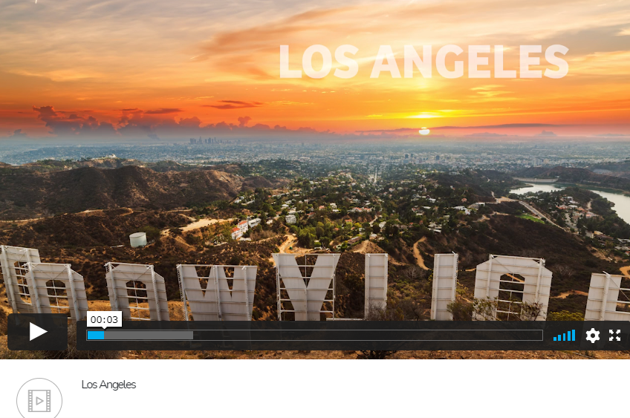

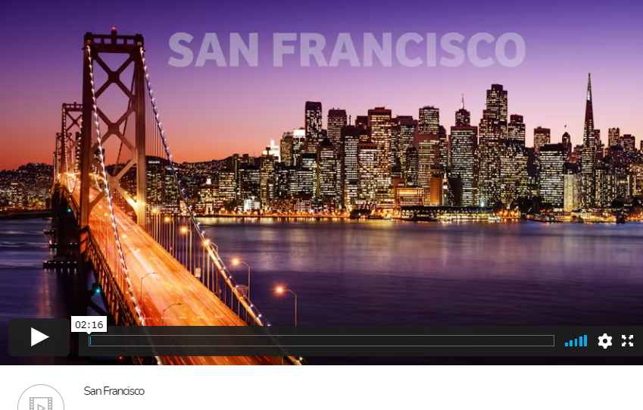
Los Angeles
San Francisco
Across cultures - California

Slide 3
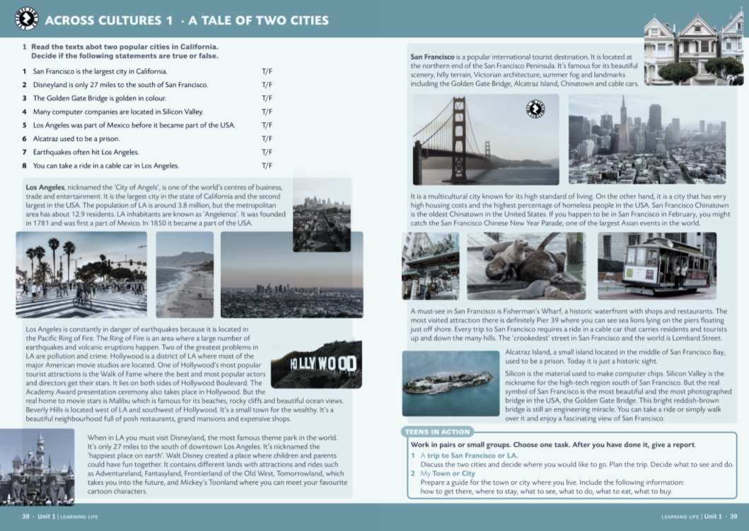



Slide 4
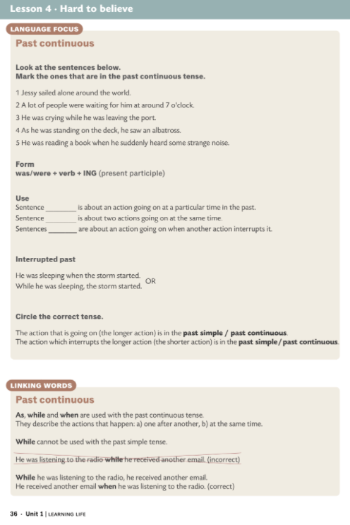
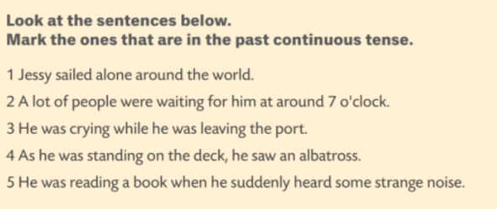

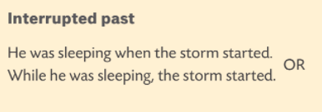


2
3
4 and 5

Slide 5
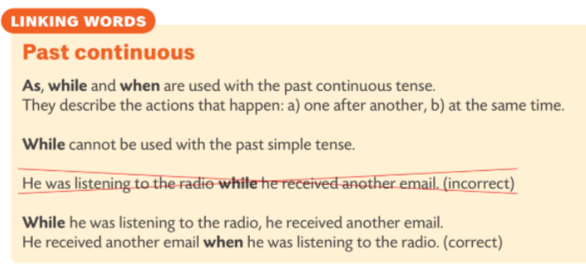
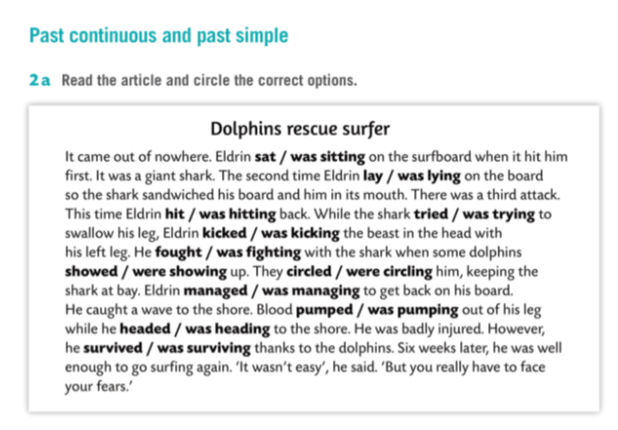

Slide 6
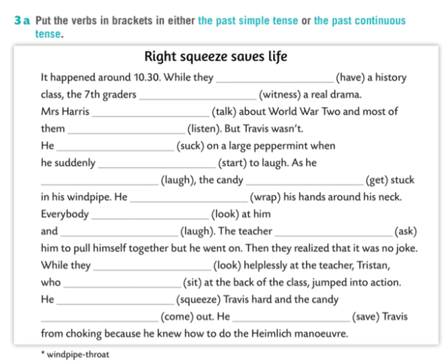

were having
witnessed
was talking
were listening
was sucking
started
was laughing
got
Past Continuous
wrapped
was looking
laughing
asked
were looking
Past Continuous (Linking words)
was sitting
squeezed
came
saved
Vocabulary (crossword)

